Slide 1

Natural Language Processing and Text Mining 521158S-3005
Teacher in charge
Mourad Oussalah
UNIVERSITY
OF OULU

Slide 2
Project 28: Wordsense Disambiguation Using Wikipedia
Group Members
Name: Abu Taher
Student ID: 2410233
Email: ataher24@student.oulu.fi
Name: Md Rabiul Hasan
Student ID: 2410234
Email: mdrabiulhasan7890@student.oulu.fi
Name: Hans Thisanke MK
Student ID: 2407698
Email: hans.madalagama@student.oulu.fi

Slide 3

OUTLINE
INTRODUCTION
BACKGROUND
OUR WORK
TASK 1 AND 2
TASK 3
TASK 6, 7 AND 8
FUTURE WORK
REFERENCES

Slide 4

INTRODUCTION
What is Word Sense Disambiguation
In natural language there are many word which takes various meaning based on how it is being used in the sentence.
Main task of the WSD is to correctly identify the intended meaning.
Most of the time we use dictionary such as WordNet to find the correct sense of a word
Importance of WSD in NLP (e.g., improves text understanding, search accuracy, etc.)
Common applications (e.g., machine translation, search engines)

Slide 5
BACKGROUND
Approaches to WSD
Dictionary-Based: Using lexical resources like WordNet
Supervised Learning: Training on annotated datasets
Unsupervised Learning: Clustering techniques based on word context
Knowledge-Based Methods: Leveraging knowledge bases (like Wikipedia)
Embedding-Based Methods
word2vec, GloVe, transformer-based embeddings
Example: Disambiguating words using embeddings (e.g., cosine similarity)

Slide 6
TASK-1: LESK IMPLEMENTATION
Lesk algorithm
For a target word, retrieve all possible sense definitions from a dictionary (often WordNet).
Compare the words in each sense’s definition with words in the surrounding context of the target word.
Select the sense with the highest overlap of words between its definition and the context.
sentence = "I was awarded a chair in computer science.“
target_word = "chair"
["i", "was", "awarded", "a", "chair", "in", "computer", "science"]
∩
["position", "authority", "especially", "academic", "professional", "setting"]
Overlap Score: 1

Slide 7
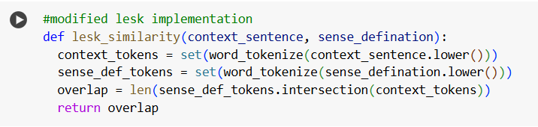
TASK-1: LESK IMPLEMENTATION
What is Lesk algorithm
It is a knowledge based approach
It calculates the overlap between all the senses of the target word and the context sentence.
It returns the best overlap

Slide 8
TASK-2: DISAMBIGUATION USING WIKIPEDIA
Target word
Return Best Sense
WiKi Disambiguation process
Search for the keyword in the Wikipedia
Retrieve the page
Extract all the text that has a hyper link
Search for those extracted text in Wikipedia
Return all the pages
Make a list of tuple (sense, text)
Compare the text with the context
Return the highest scored text, this is the sense of the target word
Wiki search
Comparison between context and text
Return wiki pages
(Sense, Text)
Extract hyperlink text
Search for hyperlink text
Figure-1: Disambiguation Process

Slide 9
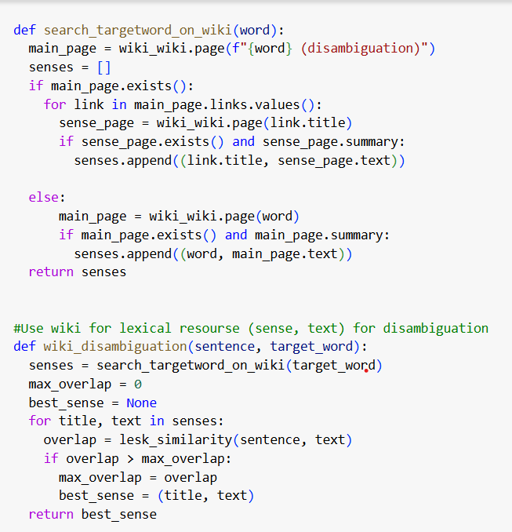
TASK-2: DISAMBIGUATION USING WIKIPEDIA
sentence = "I was awarded a chair in computer science.“
target_word = "chair"
Best Sense: Chair (academic)
Summary: Professor (commonly abbreviated as Prof.) is an academic rank at universities and other post-secondary education and research institutions in most countries.

Slide 10

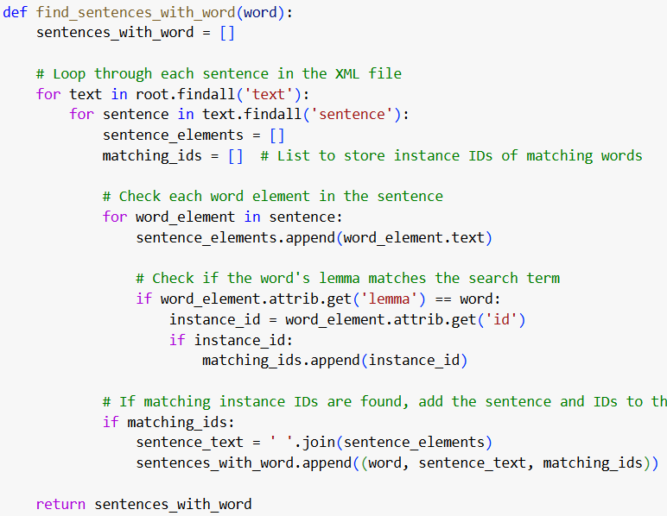
TASK-3: COMPARISION BETWEEN UNIFIED WSD AND WIKI BASED APPROACH
Data processing pipeline
Pick 10 target words
Pick 3 context sentences per word from xml file
Find the instance id of the target word in the sentence
Find sense key for each instance ID
Find wordnet definition from the sense key
Find wiki definition using target word and context sentence
Compare wordnet definition and wiki definition
Make histogram

Slide 11
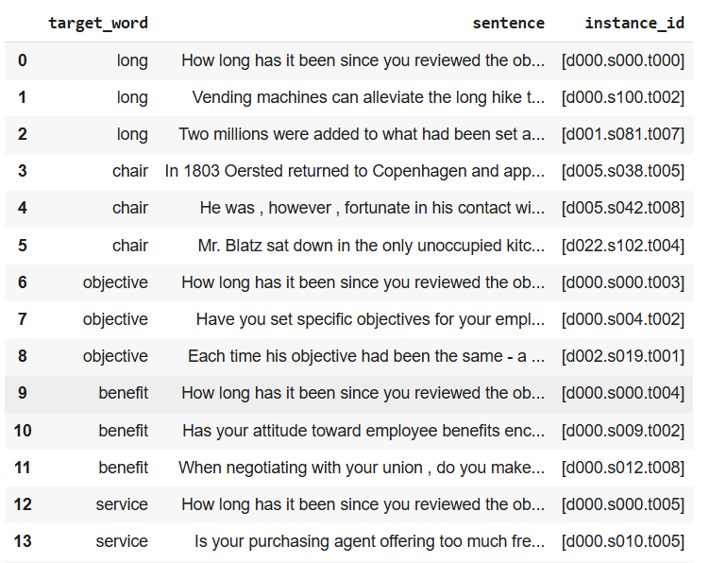
TASK-3: COMPARISION BETWEEN UNIFIED WSD AND WIKI BASED APPROACH
Data processing pipeline
Pick 10 target words
Pick 3 context sentences per word from xml file
Find the instance id of the target word in the sentence
Find sense key for each instance ID
Find wordnet definition from the sense key
Find wiki definition using target word and context sentence
Compare wordnet definition and wiki definition
Make histogram
Table-1: Sentence with instance IDs

Slide 12
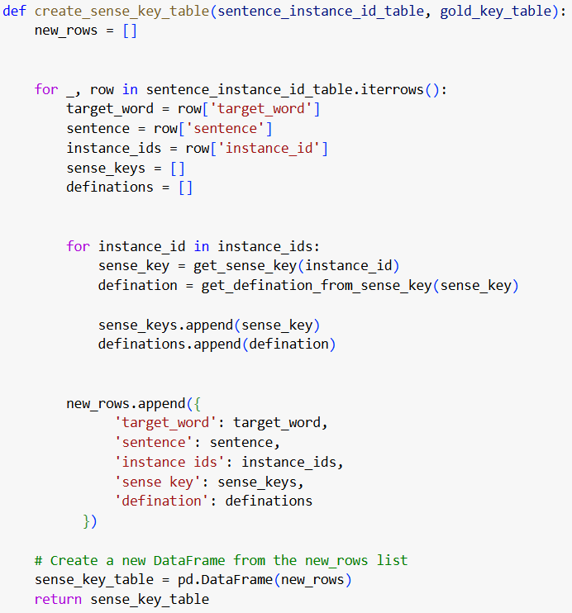
TASK-3: COMPARISION BETWEEN UNIFIED WSD AND WIKI BASED APPROACH
Data processing pipeline
Pick 10 target words
Pick 3 context sentences per word from xml file
Find the instance id of the target word in the sentence
Find sense key for each instance ID
Find wordnet definition from the sense key
Find wiki definition using target word and context sentence
Compare wordnet definition and wiki definition
Make histogram

Slide 13
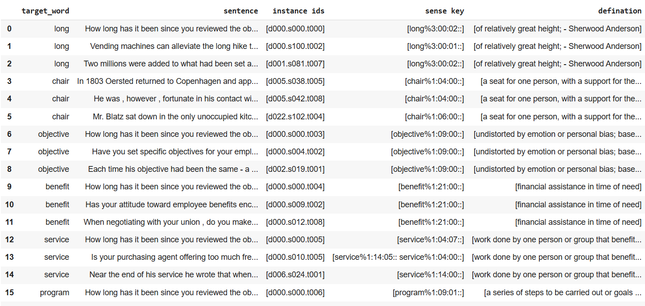
TASK-3: COMPARISION BETWEEN UNIFIED WSD AND WIKI BASED APPROACH
Table-2: Table after step-6

Slide 14
TASK-3: COMPARISION BETWEEN UNIFIED WSD AND WIKI BASED APPROACH
Data processing pipeline
Pick 10 target words
Pick 3 context sentences per word from xml file
Find the instance id of the target word in the sentence
Find sense key for each instance ID
Find wordnet definition from the sense key
Find wiki definition using target word and context sentence
Compare wordnet definition and wiki definition
Make histogram

Slide 15
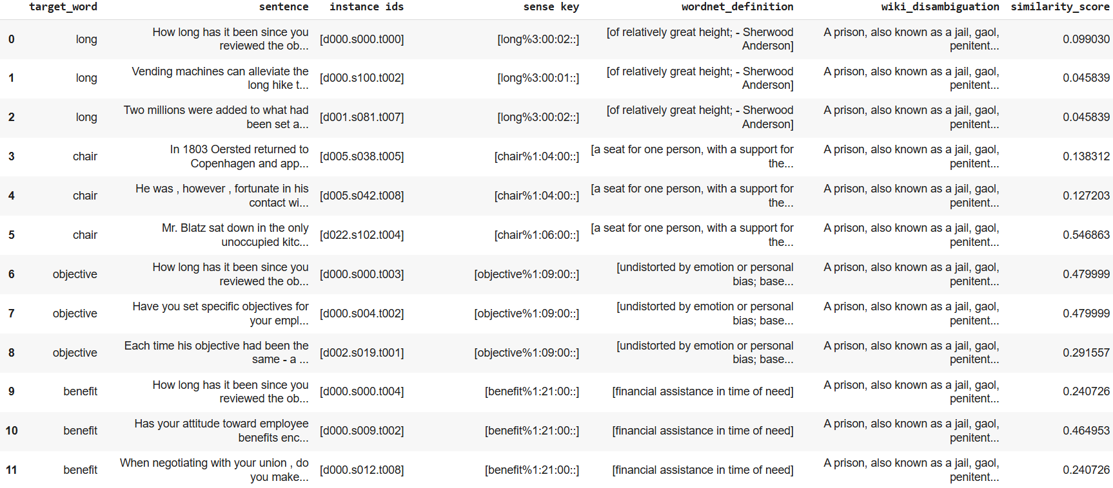
TASK-3: COMPARISION BETWEEN UNIFIED WSD AND WIKI BASED APPROACH
Table-3: Comparison between wordnet definition and wiki definition

Slide 16
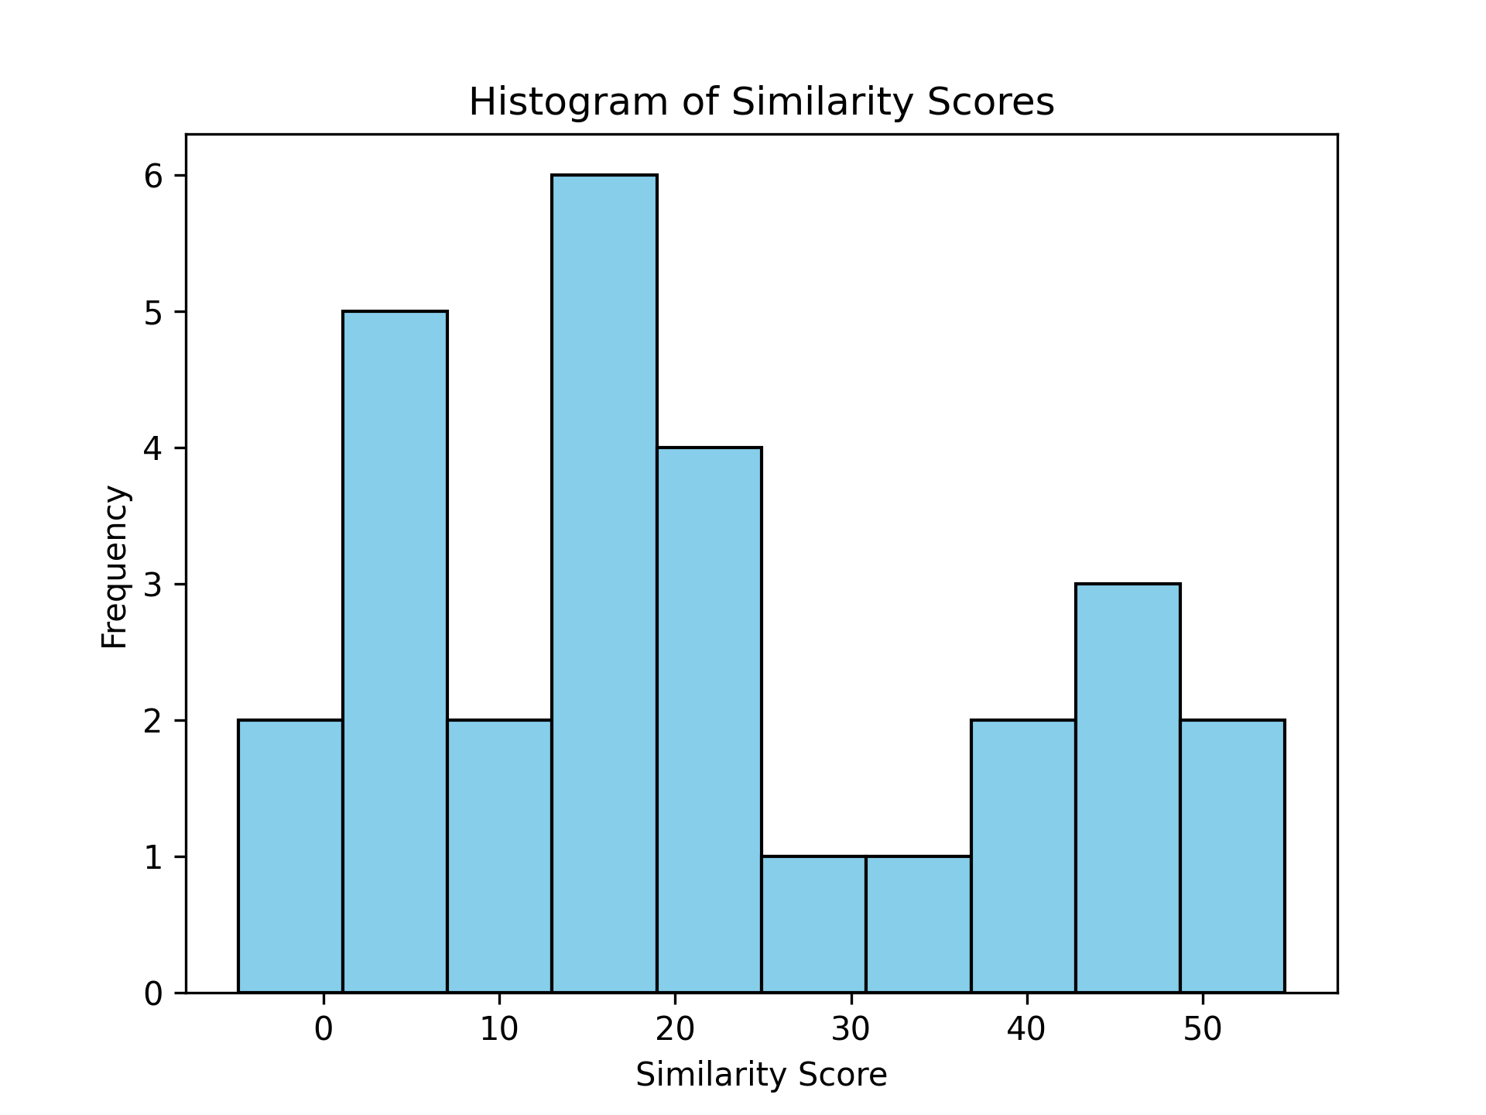
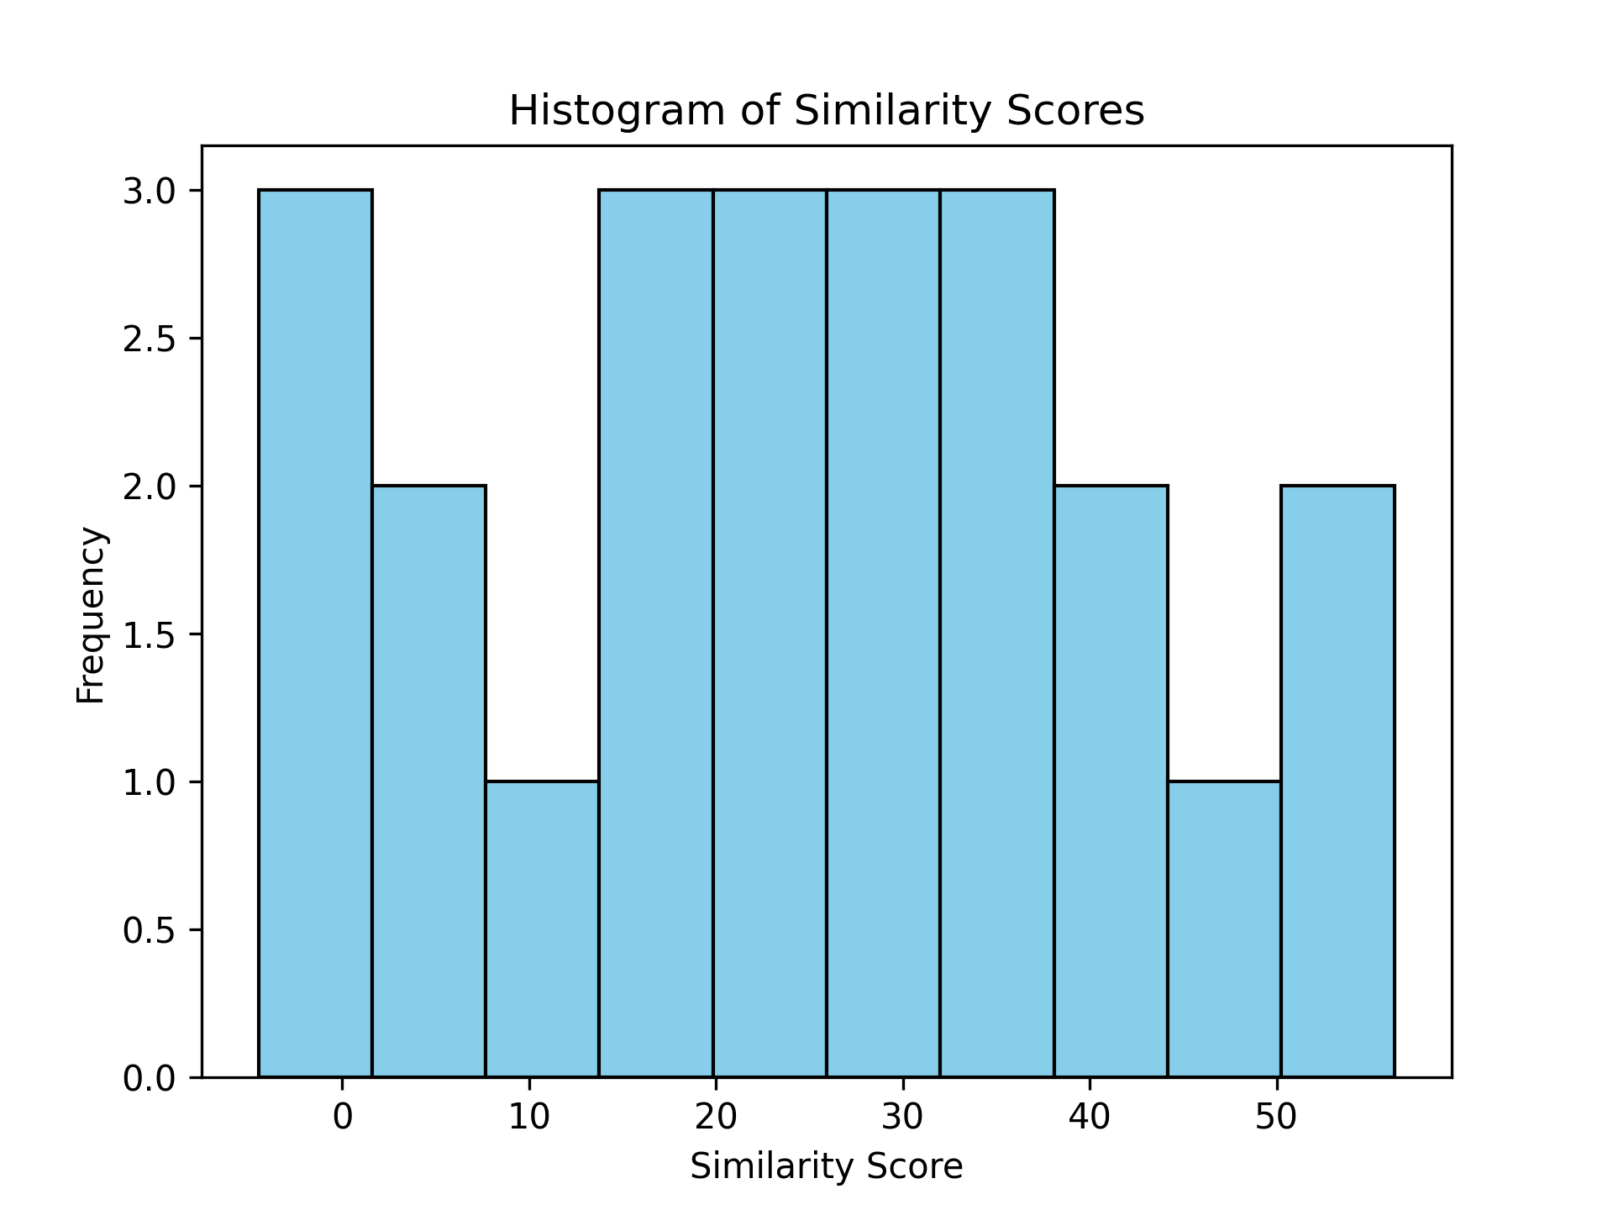
TASK-3: COMPARISION BETWEEN UNIFIED WSD AND WIKI BASED APPROACH
RESULT
Figure-2: Histogram of similarity score for first 10 words
Figure-3: Histogram of similarity score for second 10 words

Slide 17
TASK-3: COMPARISION BETWEEN UNIFIED WSD AND WIKI BASED APPROACH
Discussion
Limited annotation. Most pages are not annotated.
Some time the search produce page not found
Some target word do not have any wordnet definition
Lesk base overlap calculation
Can not capture the semantic meaning between two text

Slide 18
TASK-6: ONWARDS - Wikipedia2Vec
Wikipedia2Vec Framework Specification
A tool for embedding vector representation of words and entities
Embeddings learn through word-based skip gram, anchor context and link graph models
Major use-cases of the vector embedding model
Similarity Comparisons
Text Classification
Question Answering
Named Entity Disambiguation
Pre-trained embeddings vectors available in dimensions of 100d, 300d and 500d
For the task we perform comparison with pre-trained vector models loaded through gensim,
word2vec (word2vec-google-news-300)
GloVe (glove-wiki-gigaword-300)
FastText (fasttext-wiki-news-subwords-300)
Compare With : Wikipedia2Vec (enwiki_20180420_300d)

Slide 19
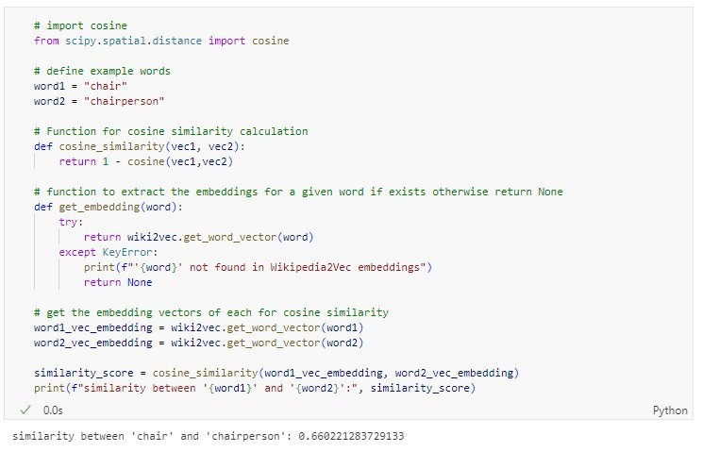
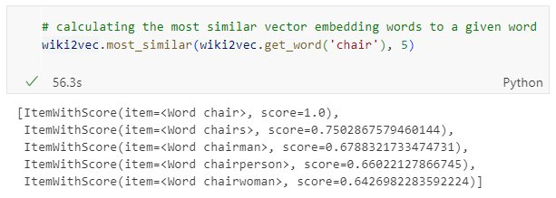
TASK-6: Wikipedia2Vec IMPLEMENTATION & COMPARISONS
Simple word pair similarity
Functions from Wikipedia2Vec library
Function: model.get_word_vector(#word) - extract the word embedding vector
Function: model.most_similar(get_word(#word), 5) - extract the most 5 similar words with the given word
Word pair similarity score concept can be applied to word-sense disambiguation in a given context

Slide 20
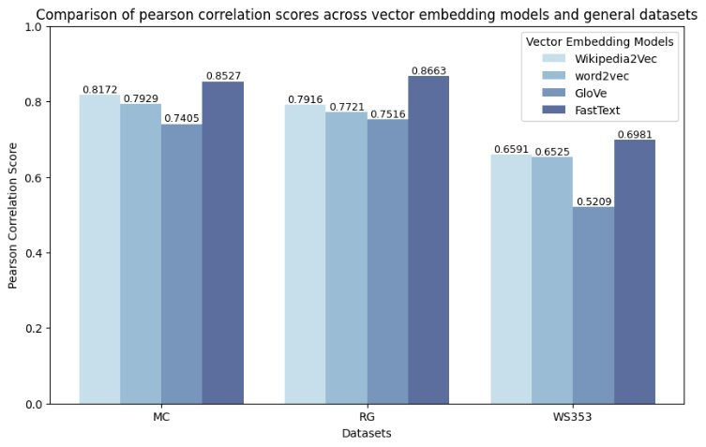
TASK-7: Wikipedia2Vec IMPLEMENTATION & COMPARISONS
Evaluate embedding models with benchmark datasets
General datasets with ground truth scores
Benchmark dataset description | Word pairs | Score scale
MC(Miller-Charles) | 30 | 0 – 4
RG(Rubenstein-Goodenough) | 65 | 0 – 4
WS353(WordSim) | 353 | 0 – 10
Table-4: Benchmark dataset details
Results - Wikipedia2Vec performance
The model achieved around 80% correlation with MC and RG datasets.
Performs better than word2vec and GloVe embedding models for all benchmark datasets.
Competitive scores with FastText model.
Figure-4: Correlation comparison bar chart

Slide 21
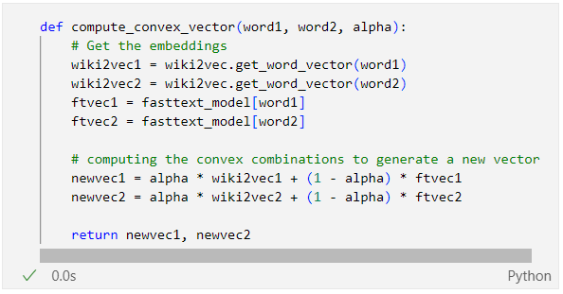
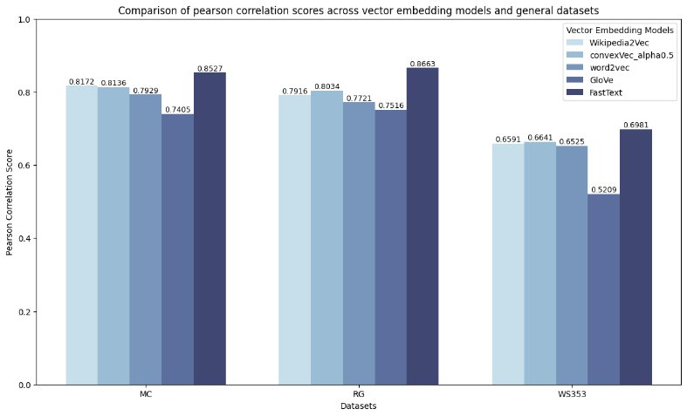
TASK-8: Wikipedia2Vec IMPLEMENTATION & COMPARISONS
Evaluate convex combination vector model with benchmark datasets
Convex combination factor addition between Wikipedia2Vec and FastText to generate new vectors
Results - ConvexVec(factor=0.5) performance
Slight improvement on correlation scores in RG and WS353 datasets.
The correlation scores seem to fluctuate between original Wikipedia2Vec and FastText models.
Figure-5: Correlation comparison bar chart with convex model

Slide 22
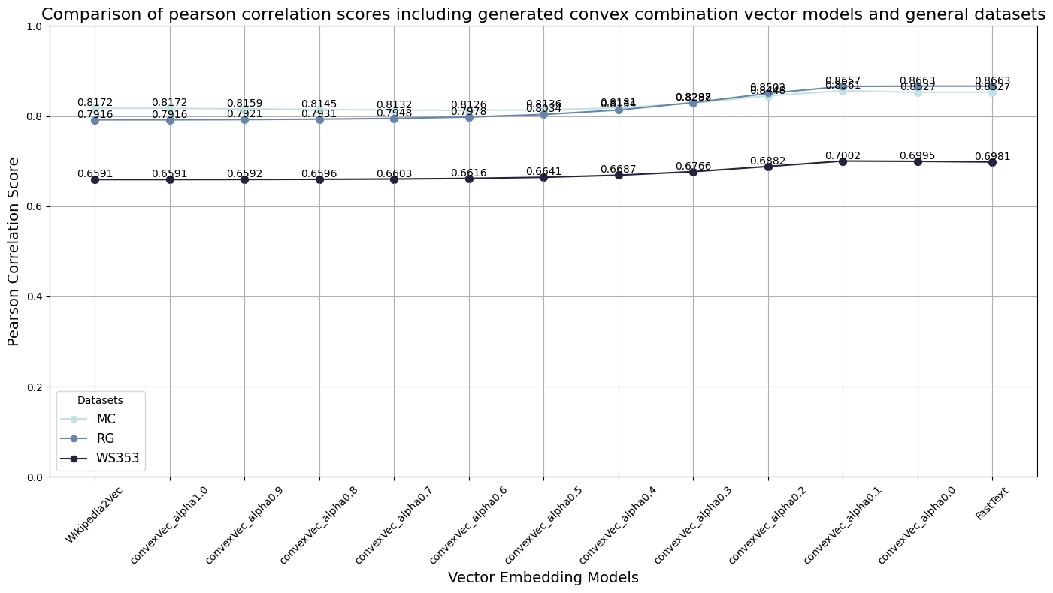
TASK-8: Wikipedia2Vec IMPLEMENTATION & COMPARISONS
Evaluation of performance with various convex combinations factors
Convex combination factor (alpha range: 0 - 1 , change with 0.1 step)
Results – ConvexVector performance
The line plot shows almost flat correlation change from alpha 1.0 - -> 0.5
The correlation scores gradually increase from alpha 0.6 -- > 0
A similar correlation increment pattern can be observed in all benchmark datasets
Figure-6: Correlation comparison line chart for benchmark datasets

Slide 23
FUTURE WORK & PLAN FOR COMPLETION
Remaining tasks for completion and limitations
Task-4 require a new dataset. We know how to do it, we just need some time
Wikipedia2Vec model and Wikipedia senses combining for example Wordsense disambiguation
Extract possible senses/glosses for the target word from a lexical database
Compare context word/entity similarity scores between Wikipedia2Vec vectors and each sense word vectors
Based on highest average similarity decide the appropriate sense for the target word
Testing BERT disambiguation model on AQUIAINT dataset.
Limitation: A free version of the dataset is not available with the provided links or from web search
Future directions in word-sense disambiguation
Combining other models such as word2vec and GloVe with Wikipedia2Vec for overall convex combination comparison
Comparision between Lesk implementation and Wikipedia2Vec method
Real-time application for word sense disambiguation with an interactive interface

Slide 24
REFERENCES
https://wikipedia2vec.github.io/wikipedia2vec
Word Sense Disambiguation: A Unified Evaluation Framework
GitHub - danlou/bert-disambiguation: Code and CoarseWSD-20 datasets for "Language Models and Word Sense Disambiguation: An Overview and Analysis"
Research Papers:
Yamada, I., Asai, A., Sakuma, J., Shindo, H., Takeda, H., Takefuji, Y., & Matsumoto, Y. (2018). Wikipedia2Vec: An efficient toolkit for learning and visualizing the embeddings of words and entities from Wikipedia. arXiv preprint arXiv:1812.06280. https://arxiv.org/abs/1812.06280
Yamada, I., Shindo, H., Takeda, H., & Takefuji, Y. (2016). Joint learning of the embedding of words and entities for named entity disambiguation. arXiv preprint arXiv:1601.01343. https://arxiv.org/abs/1601.01343
Raganato, A., Camacho-Collados, J., & Navigli, R. (2017). Word sense disambiguation: a uinified evaluation framework and empirical comparison. In Proceedings of the 15th Conference of the European Chapter of the Association for Computational Linguistics: Volume 1, Long Papers (Vol. 1, pp. 99-110).

Slide 25
Thank You!
GitHub Repo: https://github.com/hansthisanke/wordsense-disambiguation-using-wikipedia

